Slide 1
CREATE A MAVEN PROJECT
Instructor:

Slide 2
Table Content

Slide 3
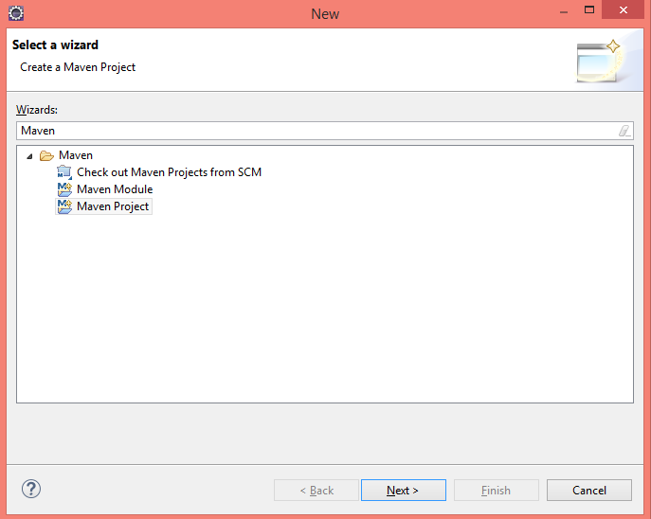
Create a new Maven project
First in Eclipse go to File -> New and from New project dialog select Maven Project.

Slide 4
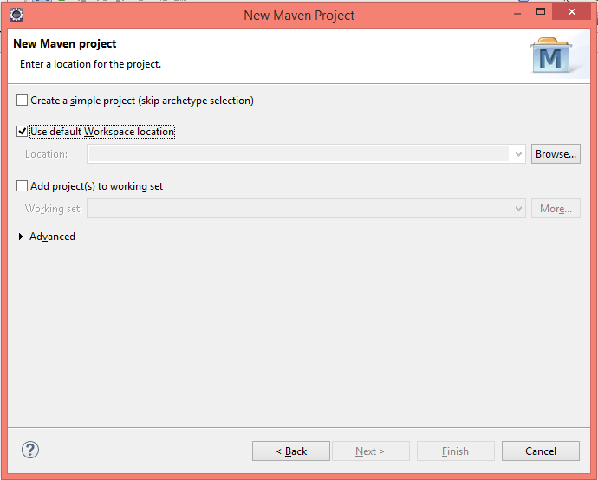
Create a new Maven project
From New Maven Project dialog, leave the options as shown below and press Next.

Slide 5
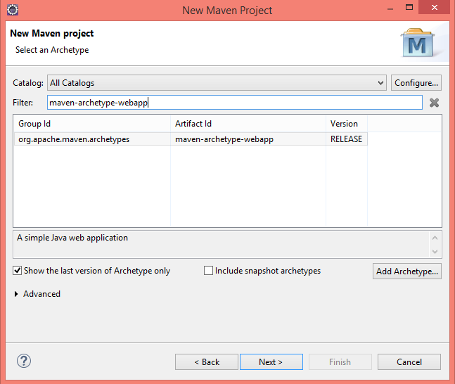
Create a new Maven project
Now select the project Archetype from the options. Type “web” in the filter text and select maven-archetype-webapp.

Slide 6
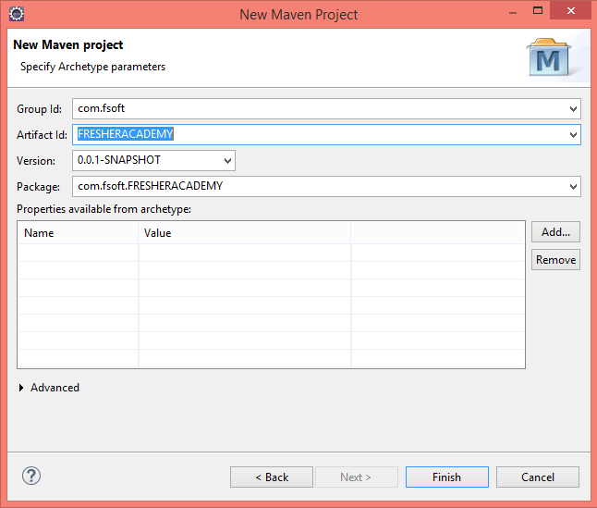
Create a new Maven project
As shown below, provide the Group Id and Artifact Id. For this example I have given Group Id com.fsoft and Artifact Id as FRESHERACADEMY.

Slide 7
Create a new Maven project
Once you press Finish.
Your Maven Project should look like this.

Slide 8
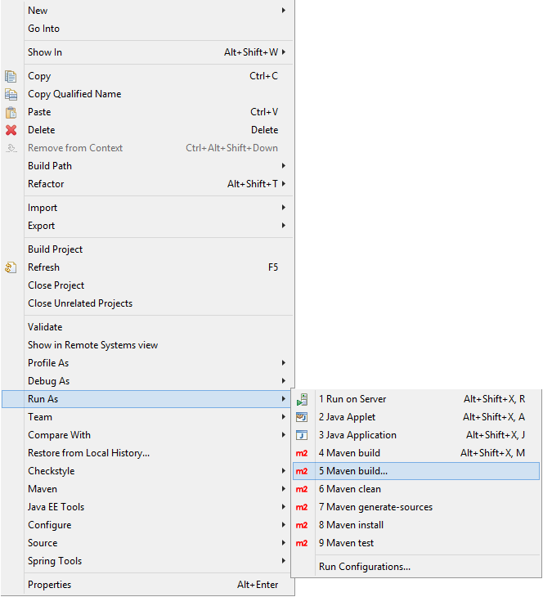
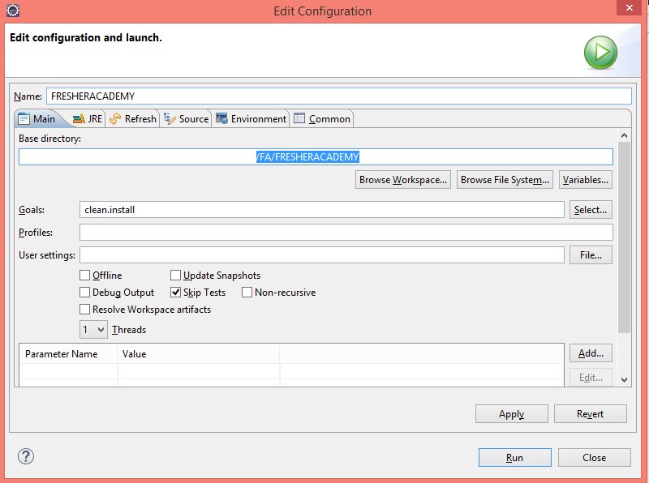
Create a new Maven project
Now build project with “Maven Clean Install” to check there isn’t any dependency issue with project.
Notes:
Reference: http://crunchify.com/how-to-create-dynamic-web-project-using-maven-in-eclipse/

Slide 9

Thank you
9

